Slide 1
Pay-As-You-Go Monetization using Crypto Mining
Billy thornton

Slide 2


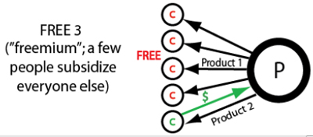
Project Premise Recap
Ads
Subscription
Freemium

Slide 3
The Issues with Blockchains
Hardware Inequality
Proof Of Work
Price Volatility
Mining Difficulty

Slide 4
System Architecture
Miner 1
Share
Mining
Pool
Miner 2
Miner 3

Slide 5
Reward Distribution
Miner 1
Miner 4
Block Reward
(5 Coins)
Content Creator 1
Content Creator 2
Miner 2
Miner 5
Miner 3

Slide 6
Potential Problems
Botting/Sybil Attacks
Content Piracy
Both off platform and onto platform

Slide 7
Progress So Far
SLOW

